Slide 1
PHYSICAL LITERACY FOR LIFE
Perspectives
Rose-Marie Repond
European Physcial Education Association
Erasmus+ Sport Project / ISCA
Notes:
Ladies and gentlemen, dear colleagues, I would like to thank you for giving me the opportunity to discuss with you a subject that is important to me, physical literacy.

Slide 2
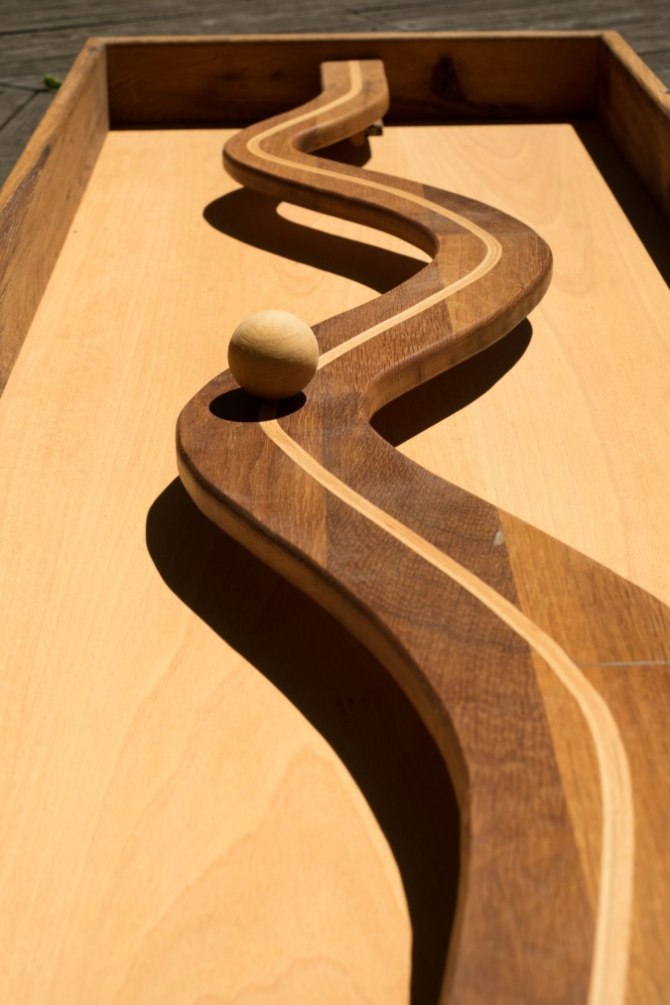
Physical literacy as a learning life long journey
Literacies and physical literacy
WHAT is physical literacy – definition and domains – strengths
Physical literacy and the institutions
WHY is Physical literacy important - education, health
Physical literacy within the society
WHERE am I an my Physical literacy journey - self assesment
HOW to implement Physical literacy
Video – Physical literacy for life
4 domains
Notes:
Physical literacy involves a continuum of learning by enabling individuals to achieve their goal. We’ll discuss together what is physical literacy, why is it important, what is our level of physical literacy and how we can contribute to its development

Slide 3
1. Physical literacy as a life long journey
All literacies are about learning
Literacy is crossing all aspects about life, not only language arts
Physical literacy can be learn in different aspects of the school and does not stop when we finish school.
In a «metaphorical sens, as developing literacy within a physical setting, synonymous to reading and writing, and specific to the culture in which individuals live» (Delaney et al., 2008)
Notes:
Literacy is a complex concept, which continues to be interpreted and defined in multiple ways. The United Nations Resolution 56/116 (UN 2002) acknowledges the place of literacy at the heart of lifelong learning.
It also acknowledges its fundamental role for the attainment of essential skills that enable people of all ages to address the challenges they may face in life. Furthermore, literacy represents one of the essential steps in basic education – an important means for effective participation in the societies and economies of the twenty-first century.
U?NESCO has kept emphasizing the need for new forms of literacy (UNESCO IBE 2017). These relate particularly to new technologies such as digital literacy, information literacy, mass-media literacy, and social-media literacy, which are increasingly taken into account in the curriculum. The concept of physical literacy recognizes that humans learn for different reasons, whether for survival, social connection, or self-actualization. Learning to move could even be considered the first literacy we truly need to acquire as humans – at least well before we need to learn to read, write, comprehend, and calculate.
The ability to move with confidence and competence, using all the physical assets one has at their disposal at any given point in time across varying context - this is a part of physical literacy.

Slide 4
2. What is Physical literacy? Definition
Physical literacy is the skills and attributes individuals demonstrate through physical activity and movement across their life course.
It can be understood as a process and as an outcome that individuals pursue through an interaction of their physical , emotional, social and cognitive learning.
Notes:
Physical literacy is the skills and attributes - it means that if you or your Students, clients improve you should see the changes in the behovior.
Learning to move could even be considered the first literacy we truly need to acquire as humans – at least well before we need to learn to read, write, comprehend, and calculate. The concept of physical literacy recognizes that humans learn for different reasons, whether for survival, social connection, or self-actualization.
It can be understood as a process and as a outcome : the process is the way, the journey and the outcomes the progress, the success, the learning results …. The elements that you will have to connect , coming from different domains.

Slide 5
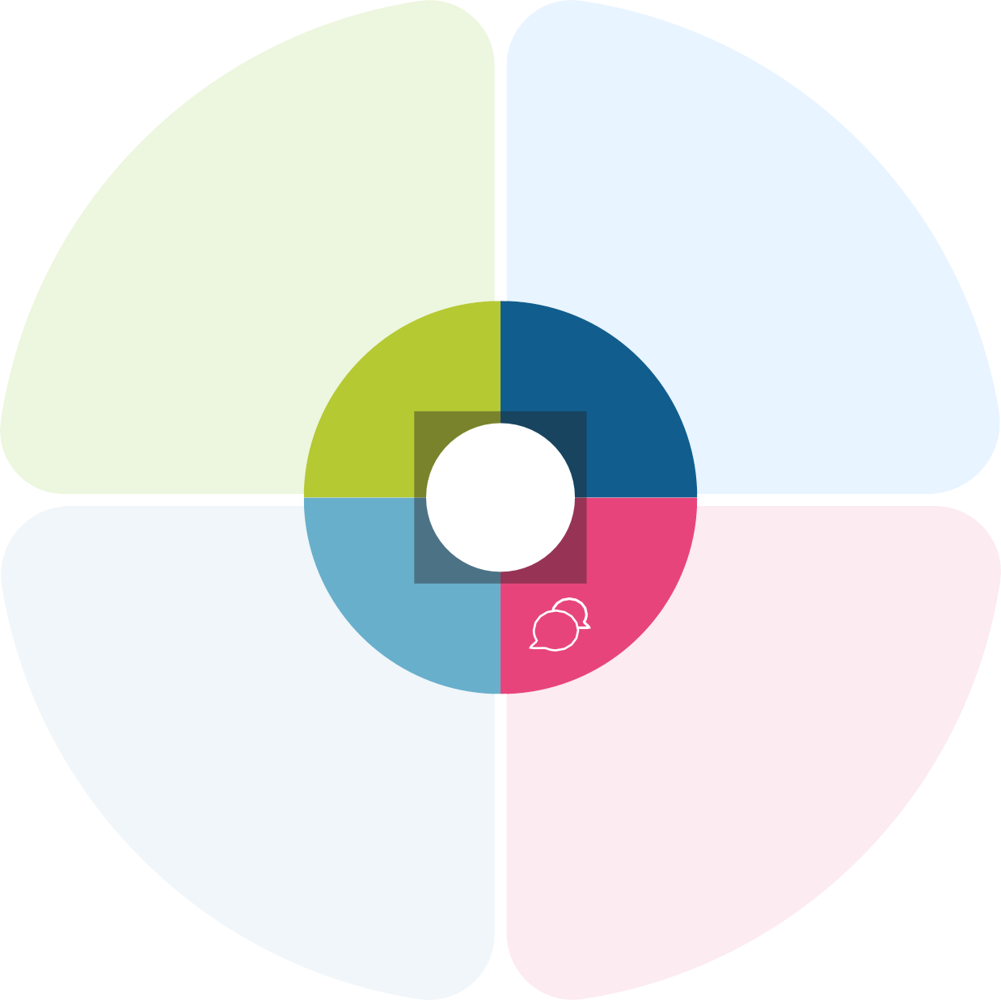

4 domains in Physical literacy
Physical domain
Interrelated
Supporting the holistic development of PL
Helping all generations to lead active, healthy and fulfilling lifestyles
Cognitive domain
PL
Emotional domain
Social domain
Notes:
Which domains : the four domains : physical, cognitive, emotional and social …
Those domains are interrelated .
For example I learn how to ski, which is an object of locomotion-type skill. Learning to ski is not directly linked with social understanding –but because skiers are very territorial I need to link that with an emotional experience like the connection to the environment. I can also ski with friends, on a resort with other people …. In a wild environment… Soo the more bonds and learning elements that I can piece together around different type of movements, the more likely that I will be able to pursue them across my entire life.
To connect the elements, is the strength of PL.

Slide 6
The strength of physical literacy
People with a high level of physical literacy have elements from different learning domains
What makes people pursue physical activity across the life span : when those elements bond with other elements so they turn into these movement compounds.
Physical literacy is elemental – D. Duddley likes to think of all the different components as part of a periodic chart. People with a high level of physical literacy have elements from different learning domains.
Notes:
Physical literacy is elemental – D. Duddley likes to think of all the different components as part of a periodic chart. We all have elements from different learning domains whether it be social, cognitive, emotional or physical. People with high level of PL have more elements and more connections , and what makes people pursue physical active across the life span is when those elements bond with other - this could also be seen as Lego bricks – the more you have, the more you can construct, but you need to know which brick to use where , like in a connection environment.
Personal, social and learning to learn competence . It includes the ability to cope with uncertainty and complexity, learn to learn, support one’s physical and emotional well-being, to maintain physical and mental health, and to be able to lead a health-conscious, future-oriented life, empathize and manage conflict in an inclusive and supportive context. Attitudes: The competence is based on a positive attitude toward one’s personal, social and physical well-being and learning throughout one’s life.

Slide 7
3.Physical literacy – EU, UNESCO
European policy context : Key competences and basic skills development :
  … promoting a variety of learning approaches and contexts, in a lifelong learning perspectives
UNESCO : in line with the Charter – a proposal to establish common pilars of Physical Literacy (2017)
Kazan action plan: physical education, physical activity and sport are “fundamental rights for all” – and as such, constitute important components of equitable and quality education (SDG 4.1). Physical literacy provides the basis for lifelong participating in physical activity and health benefits.
Notes:
The aspirational goal of achieving a physically literate population begins with rethinking and applying good learning design in school and out-of-school movement experiences. In the Key competences of the EU curriculum no sign of physical literacy looking in the recommendations, we can find, im the introduction : Everyone has the right to quality and inclusive education, training and lifelong learning that develops key competences and basic skills. Key competences and basic skills are needed by all for personal fulfilment and development, employability, social inclusion and active citizenship. The competence is based on a positive attitude toward one’s personal, social and physical well-being and learning throughout one’s life.
Using UNESCO’s (2015b) Quality Physical Education: Guidelines for Policy-Makers, UNESCO and partners are currently supporting different projects (Fiji, Mexico, South Africa, and Zambia) to develop inclusive, child-centered school policies and processes driven by physical literacy.
These policies promote physical literacy and values-based learning as part of rounded development and global education priorities such as the SDG 4. as also n the Kazan action plan .

Slide 8
Physical literacy – WHO, OECD, IOC
Global Action Plan for Physical Activity (2018-2023)
  … incorporating a Physical literacy across the life course and the ability range
  Strengthen formal training on physical education, physical activity, fundamental movement skills and physical literacy (members) ….
OECD : “Stock-taking Exercise on Physical and Health Education “ – first time that OECD focus on physical and health education as part of it policy analysis (Education 2030)
IOC: Physical activity exists in many forms, including, but not limited to, sport, recreation, unstructured play, dance and exercise. Not all children have positive experiences in sport and physical activity. We want to change that. (Olympic Values Education, preface)
Notes:
Health and sport agencies must collaborate with education in creating a strategic vision that enables the fundamental right for all people to participate in meaningful physical activity across their life course.
In the Recommended actions for WHO Member States, physical literacy is clearly mentioned. CITATION
The international stakeholders of the OECD Future of Education and Skills 2030 project highlight three foundations as particularly important: cognitive foundations, which include literacy and numeracy; health foundations, including physical and mental health, and well-being; social and emotional foundations, including moral and ethics and digital literacy and data literacy.
When we talk to people about physical literacy, we tend to talk about it within “strength space thinking , identifying people strength. We work through positive previous experiences. Physical literacy as a concept of learning may contribute to the change mention in the preface of the Olympic Values Education, to include all the persons in a project of long life physical activities.

Slide 9
4. WHY is PL important ?
PL challenges the way in which individuals engage in and understand physical activity
PL offers an alternative approach to encourage individuals to engage in physical activity to improve themselves by developing their physical , cognitive, emotional and social attributes.
PL is the golden thread that radiates through play, physical education physical recreation, fitness, sport, active lives.
Human learn for different reasons – PL becomes self-evident as individuals engage with the work and learn to move their bodies for different reasons
Notes:
We learn to read, write, count …. But also to walk, crawl, run . We don’t just get them, we lean them because we need to survive. We learn other skills to become part of the largest social group. I repeat it but this is very important : to position physical literacy as learning, we learn things to survive on this planet, to be socially included. We are starting to learn to move before learning to speak, read, ….
PL is the golden thread that radiates through all kind of physical activities, active lives.
Human learn for different reasons , PL becomes self évident as individuals engage with the work and learn to move for different reasons

Slide 10
5. Physical literacy within our society
We promote and value Physical literacy :
- we know that we need to lead more sustainable and active lives
- the new generations are living longer (in good health, learning after the formal education, taking care of the planet..)
Physical literacy as a concept can be applied to all facets of exercise, in the schools, the clubs, the hospitals, public health, with teachers, doctors, coach, trainers, aged care home, sporting infrastructure, policy makers … We need to get all these people talking together contributing where they’re best !
Notes:
Physical educaton is about quality education but ALSO about good health .
We promote and value Physical literacy CITATION
Physical literacy as a concept can be applied to all facets of exercise in different settings … We need to get all these people talking together contributing where they’re best !

Slide 11
WHY is PL in education?
PL is a concept that asks educators
  to celebrate each individual’s strengths and to use these as a foundation for learning
  Make organizational decisions and develop context in ways that help students learn new and incresingly complex movement sequences
  Not only in school ! But clubs, individual, family ….
This process is a lifelong journey – every individual engages in physical activity based on their disposition and learning - also outside of formal educational institutions.
Notes:
The tasks of teachers, educators :
Physical literacy is a concept that asks educators to celebrate each indivdual’s strenghts and to use these as a foundation for learning , and teaching , to live meningful and healthy lives through physical activity, sport, recreation, and leaisure. Educators can make a number of organisational decision and develop content in ways that the students learn new and complex movement sequences.
Richard Keegan reports on the development of a physical literacy definition and stardards framework suitable for implementation in Australia. Importantly for physical eduators, the researchers were able to firmly place physical literacy in the sphere of a learning construct underpinned by learning theory and progression that again will have meaningful implication for our work as teachers.
Education and health participate to the development of the society , we need to be active, existing healthy , and continze learning when we finish our formal education

Slide 12
Link Physical Literacy and health
Carney et al., 2019
Notes:
Despite evidence on the benefits of health enhancing physical activity HEPA, only few countries have developed health in all policies and specifically integrated HEPA policies. Carney et al. (2019) shows the important link between physical literacy and health, it may support to cross the barriers and levers for adapting cross-sectoral HEPA. As example: He is arguing from a pragmatic perspective on PL, presenting evidence for positioning PL as a determinant of health from two literature sources: research on motor coordination disorders in children, and associations between motor competence, PA and health in typically developing children.

Slide 13
6. WHERE am I on my PL journey?
What can I do , PL is determined by finding a place of comfort in terms of how you move, acquire the learning and skills to build up from that position of strength.
Pretending that the PL compounds has elements from the four domains
  As teacher, coach, policy maker : we can think about what our clients, students, player… in those four domains looking for what they need and what can be improved
  As citizen, we can think about our situation in the four learning domains
Example: Self assessment tools are existing for PE teachers, trainers and coaches, citizen :
https://physical-literacy.isca.org/tool1/
Notes:
To be able to develop PL, we ask ourself about our Physical literacy. Where am I on my PL journey ?
I would like to share with you one of the questionnaire developped for self-assesement within the project Physical Literacy for Life .
The idea is to show, to confort the participant that they are not starting from scratch – and that the PL is a process , journey.
I scape the biographical part to go directly to the question: I will start with the physical domain : ALLER DANS

Slide 14
7. HOW to implement Physical literacy?
Priority : Provide positive learning environments for individuals engaging in physical activity
New focus – on physical literacy - on the development of individual’s physical competence, attitudes towards physical activity, knowledge and understanding
Clear orientation towards encouraging everyone to be physically active (education, sport, health agencies)
Safe and inclusive learning environments in the 4 domains.
Notes:
This is a priority as PL seeks to contribute towards multiple Sustainable Development Goals , the question of how to provide positive learning environment, for individuals engaging in physical activity.
We may suggest a guide for practitioners , establishing safe and inclusive learning environnements as example:
Ensure that everybody is included and challenged according to their capability
Provide a wide range of expériences in different physical activty environnements, that are differentiated to the needs of the individual
Ensure that the activities are relevant, rewarding and challenging to every indivdual
Value knowledge, understanding and attitudes as much as physical competence
Celebrate progress and success …

Slide 15
HOW … guide for a school / a club
(https://www.sportaus.gov.au/physical_literacy)
 | CULTURE, ORGANISATION AND ENVIRONMENT |  |  | PROGRAMME, PRACTICE AND PROMOTION |  |  | PARTNERSHIPS
Component | Leadership | Policy | Environment | Quality Physical Activity Programme | Inclusive Programme | Professional Development | Families | Local Community
OBJECTIVE | Foster a culture that actively supports a whole organisation approach to developing physical literacy. | Create, implement and review a whole organisation physical literacy policy. | Facilitate access to a variety of environments that encourages the development of physical literacy. | Provide a quality Physical Education/Sport/Physical Activity programme which encompasses physical literacy. | Provide a broad range of sports and physical activities that complements the organisation and focuses on the development of physical literacy. | Encourage all practitioners to engage in professional development so they promote physical literacy across all activity areas. | Encourage families to help everyone develop physical literacy. | Engage with a diverse range of community groups to enhance opportunities for individuals to engage in physical activity and to develop their physical literacy.
Area of work
Notes:
The others questionnaires are for teachers and coaches/trainers - I would like to share with you the guide – this is the one from Sportaustralia

Slide 16
8. HOW … for you
(https://www.sportaus.gov.au/physical_literacy)
Keep in mind:
you don’t need to master all the domains
you can choose a few skills to work on at a time
what you focus on will depend on your current skills, circumstances and goals
This holistic learning enables people to draw on these integrated skills to lead healthy and fulfilling lives through movement and physical activity.
VIDEO
https://www.dropbox.com/s/av8yjj5mao11ry9/PL4L%20-%20What%20is%20PL%20Final%20video%20%282%29.mp4?dl=0
Notes:
I would like to share a video with you – this is the video original from our project PL4L, to introduce physical literacy.

Slide 17
THANK YOU
Rosemarie.Repond@eupea.com

